Slide 1



Algerian democratic and public republic
University Of Sciences and Technology Houari boumediene
The Final Project of TIC Subject
First year computer science engineer:
Section: A.
Groupe: 29.
Date: January 2024.
1

Slide 2

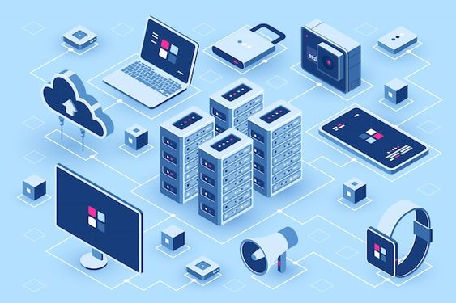




-Contents:
1. Introduction to TIC.
2. TIC and its implications.
3. Google Services.
4. Microsoft Tools.
5. Git and GitHub.
6. Conclusion.
2

Slide 3

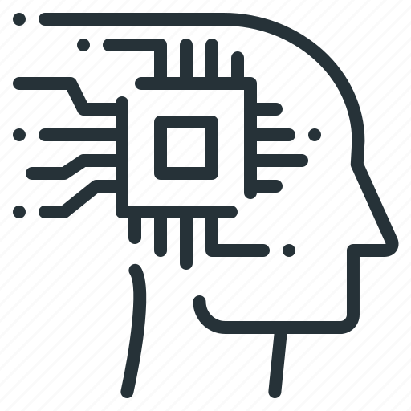

1-Introduction to TIC:
Technology, Information, and Communication (TIC) comprise digital tools and platforms crucial for accessing information, connecting people, and driving technological progress.
Key elements include internet services, communication tools, and collaborative platforms like Google and Microsoft tools, contributing to seamless communication and efficient collaboration in the digital landscape.
Inbox
3

Slide 4


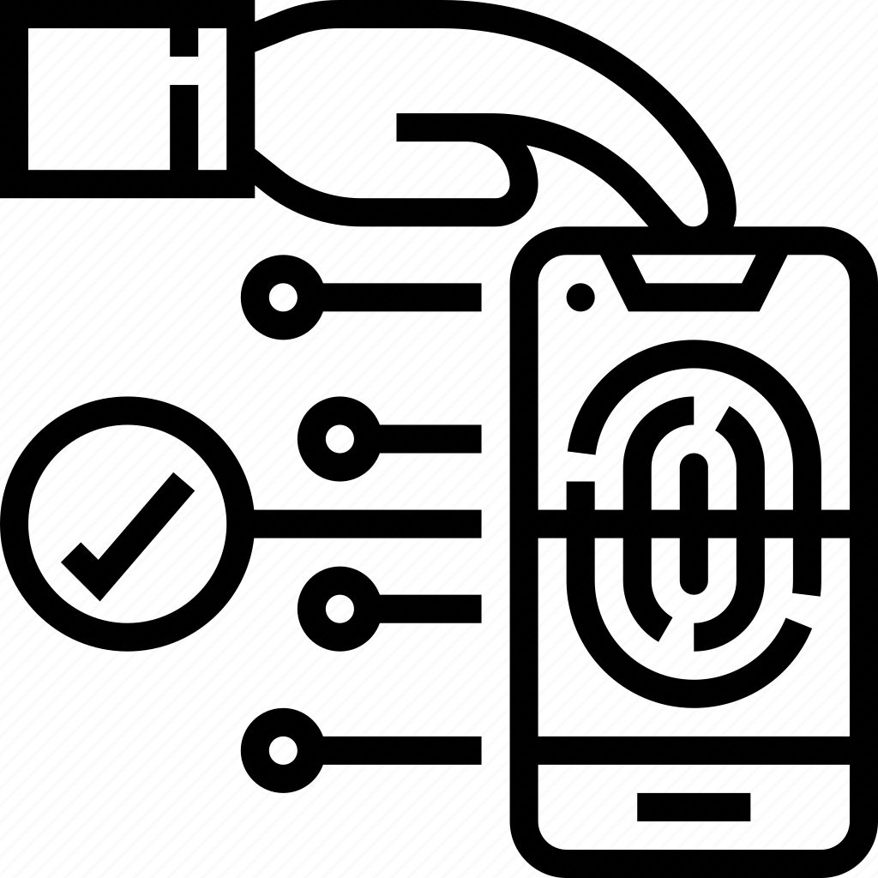


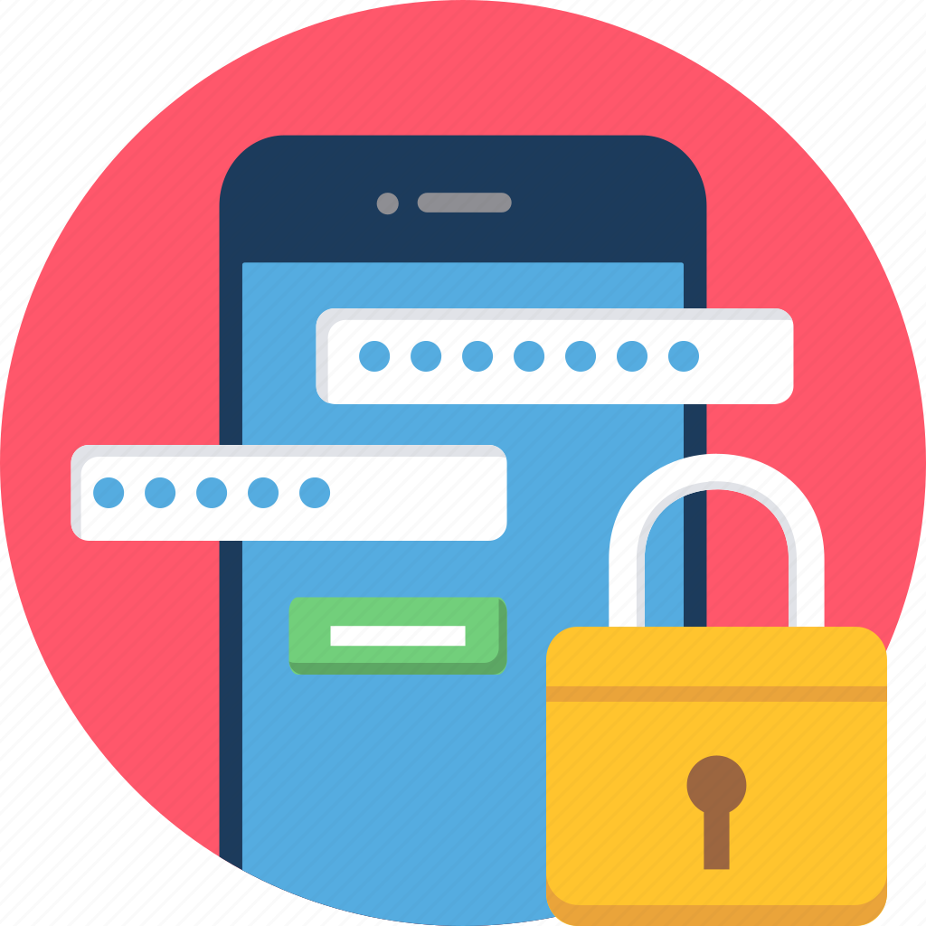
2-TIC and Its Implications:
Technology, Information, and Communication (TIC) profoundly impact modern society, with wide-ranging implications observed in key areas. grasping these implications is crucial to understanding the transformative influence of TIC.
a) Economic Development:
b) Employment and Workforce Dynamics:
c) Access to Information:
TIC is crucial for economic growth, driving innovation, productivity, and new business models. It fosters entrepreneurial opportunities, facilitates global trade, and supports digital economy expansion.
TIC revolutionized access to information, democratizing knowledge by offering unprecedented access to education, research, and global perspectives.
TIC transforms labor markets, creating new job roles, skill demands, and remote work options. It fuels the gig economy and the rise of digital skill-based careers.
d)Communication and Connectivity:
e)Social and Cultural Impact:
f)Ethical and Privacy Considerations:
TIC transformed communication, fostering global connectivity with real-time collaboration, video conferencing, and social interaction. It bridges cultural gaps, enabling seamless connectivity across geographical boundaries.
TIC has shaped societal norms, fostering cultural exchange through virtual communities. It redefines interaction modes, influencing social dynamics and enabling diverse cultural expressions on digital platforms.
TIC raises ethical and privacy concerns, demanding regulations and ethical guidelines for data protection, online security, and responsible technology use. Complex issues require systematic approaches to address these challenges.
4

Slide 5
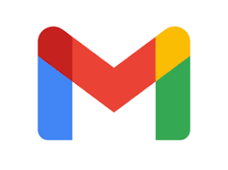

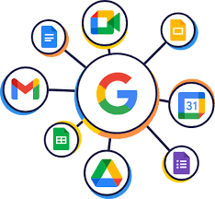
3- Google Services:
Google's suite, crucial for Technology, Information, and Communication (TIC), offers robust tools like Gmail, Google Drive, and Google Workspace, enhancing communication, collaboration, and information management.
-Gmail: | -Google Drive: | -Google Workspace:
Gmail revolutionized email with a user-friendly interface, efficient spam filtering, and ample storage. It profoundly impacts communication, providing a reliable platform for messages, file attachments, and contact management. Seamless integration with Google services enhances productivity and information sharing. | Google Drive, a cloud-based hub, transforms information storage and access, enabling seamless collaboration on files and documents. Sharing features redefine how individuals and organizations manage and distribute information. | Formerly G Suite, Google Workspace revolutionizes collaboration with tools like Docs, Sheets, and Slides. It transforms team dynamics by enabling real-time collaboration on various tasks. Google Workspace also includes communication features like Meet for video conferencing and Chat for instant messaging and collaboration.
Google services revolutionize communication, collaboration, and information management, enhancing productivity through seamless email, real-time document collaboration, and centralized storage, fostering efficient and unified workflows in modern TIC practices.
5

Slide 6
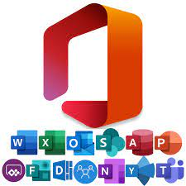
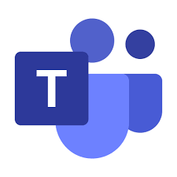
4-Microsoft Tools in the Context of TIC:
Microsoft provides a suite of TIC-focused tools like Office 365, Teams, and SharePoint, elevating communication, information management, and productivity within organizations.
-Office 365:
-Microsoft Teams:
Mirosoft 365, formerly Office 365, is a robust productivity suite with essential applications like Word, Excel, PowerPoint, and Outlook.
Microsoft Teams is a versatile platform that combines chat, video conferencing, file storage, and application integration in one interface for seamless communication and collaboration.
Office 365, a cloud-based solution, facilitates easy access to documents, email, and communication tools across devices with internet connectivity.
Teams promotes efficient collaboration through secure messaging and file sharing, fostering real-time communication and information exchange among teams, regardless of their geographical locations.
The suite enhances collaboration with real-time document editing, online meetings, and file sharing, fostering elevated communication and productivity.
Teams' integration with Office 365 and third-party tools boosts its utility in supporting TIC (Technology Integration and Communication) practices.
6

Slide 7
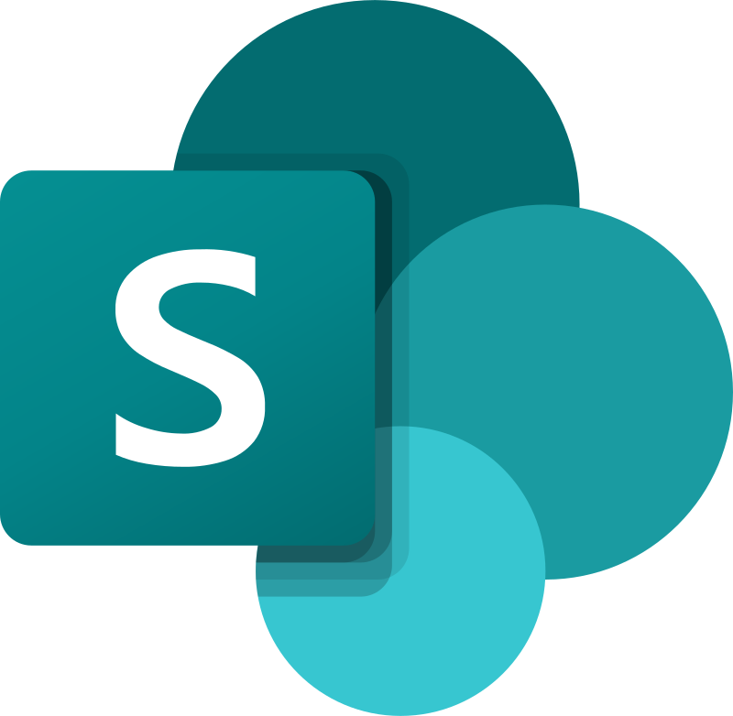
- SharePoint:
SharePoint is a web-based platform that serves as a central hub for document management and collaboration within organizations.
It enables the creation of intranet sites, document repositories,and team sites, providing a scalable solution for informationmanagement and sharing.
SharePoints features such as version control, access permissions, and integration with other Microsoft tools contribute to effective information management and collaborative workflows.
Microsoft tools like Office 365, Teams, and SharePoint play a crucial role in supporting TIC (Technology Integration and Communication) practices by providing strong solutions for communication, collaboration, and information management in modern organizations. Their integration with other TIC-related technologies underscores their importance in improving productivity and connectivity across diverse environments.
7

Slide 8
5-Git and GitHub:
Git, a distributed version control system, empowers developers to track code changes, manage versions, and collaborate seamlessly. GitHub, a platform around Git, offers collaborative tools, code hosting, and project management features, fostering communication and coordination among developers. Together, Git and GitHub create a framework for efficient collaboration, enhancing transparency and knowledge sharing within developer communities, crucial for successful and scalable software development projects.
8

Slide 9
6-Conclusion:
Technology Integration and Communication (TIC) have significantly reshaped business operations and societal dynamics. TIC streamlined processes, transformed communication, and democratized access to information, enhancing efficiency and informed decision-making in business. Societally, it influenced education, employment, and digital inclusion. The future role of TIC entails continuous evolution, deeper integration into daily life, and ethical considerations. TIC will play a pivotal role in shaping a globally connected world, addressing challenges like cybersecurity and environmental impact. Embracing these technologies responsibly is key to fostering a more inclusive, innovative, and sustainable digital future.
9

